Slide 1
Text based therapy
A guide by Ivo Su

Slide 2
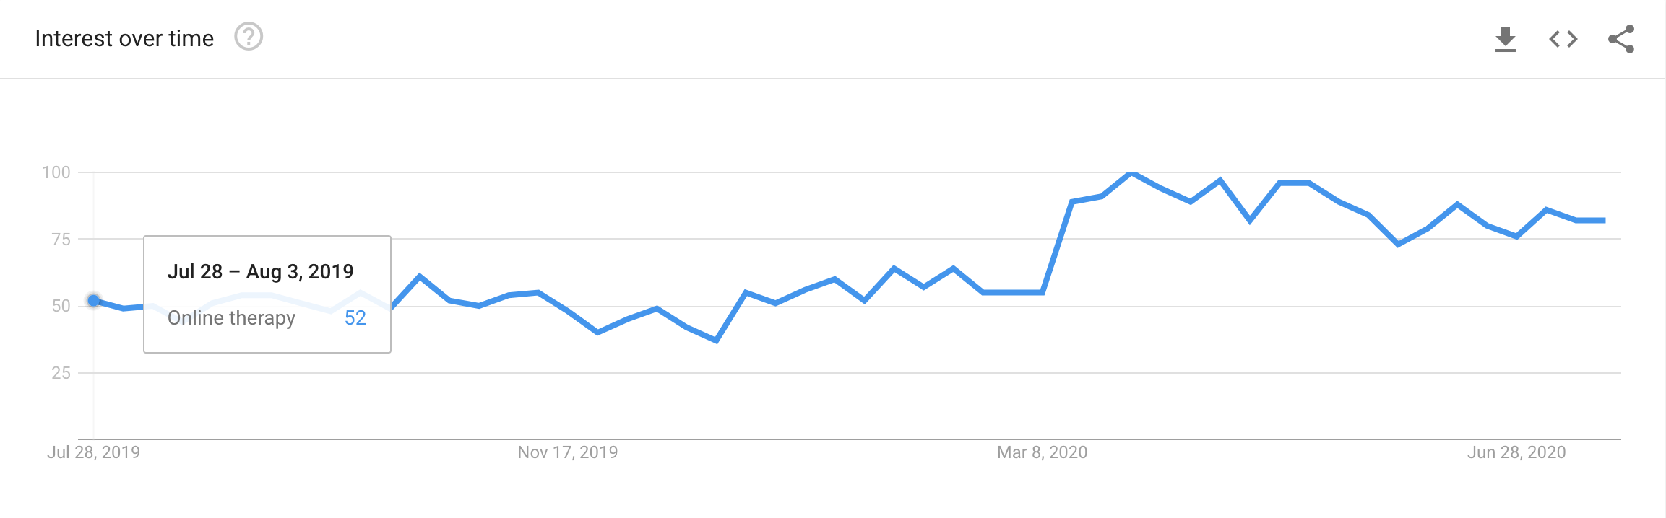
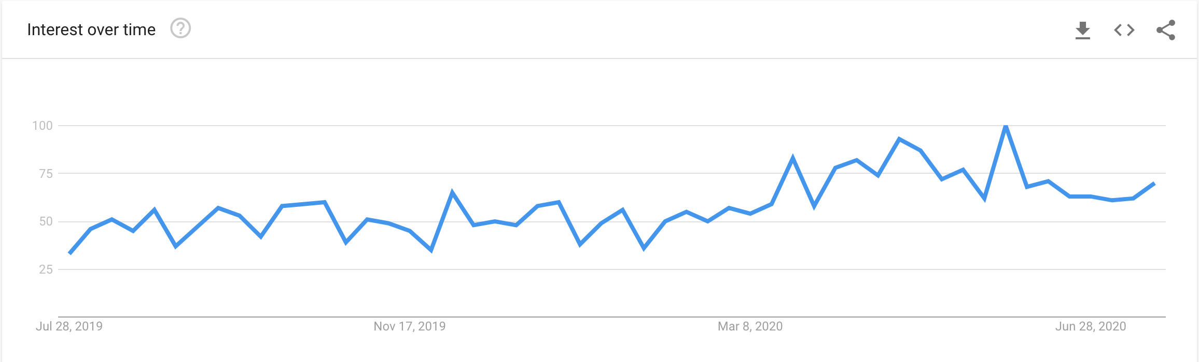
Why Online Therapy?
Because of COVID-19, people are searching for therapy and counseling online at a rate higher than ever.
Searches for Online Therapy
Searches for Talkspace

Slide 3


1. Key Components
Tone Make the customer feel relaxed.
Animosity Give customers the option to stay anonymous.
Quickness Provide networks that can respond quickly.

Slide 4
How can we reach out to teenage and adult atheletes?

Slide 5

Texting!
Teenagers are the largest user base of existing online therapy platforms.

Slide 6
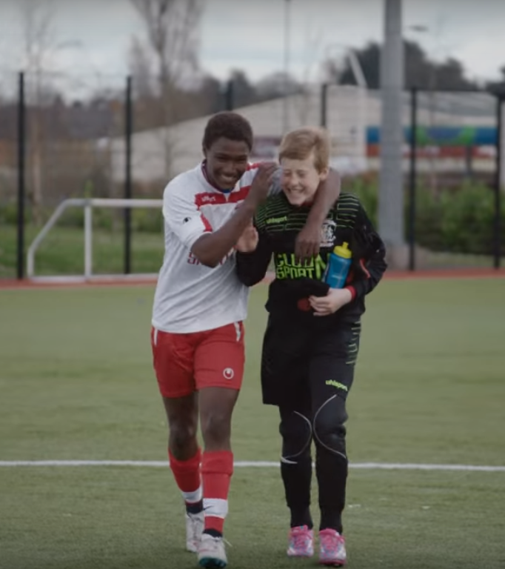
Texting and using popular trends like emojis can attract teenagers to use the services.

Slide 7
2. Remain anonymous
Athletes, particularly males, tend to hold stronger stigma with mental health issues
What Give them the choice to remain anonymous, so they are not afraid to share their problems.
.

Slide 8

10-15% of athletes will experience mental health issues

Slide 9

Mental Health stigmas.
Athletes are more worried about body shape, they are more likely to self doubt

Slide 10

We can help them
Remaining anonymous can help alleviate their worries about mental health stigmas.

Slide 11
3. Quickness
People need to understand how rare or frequent your examples are.
Pick 1 or 2 statistics and make them as concrete as possible. Stats are generally not sticky, but here are a few tactics:
Relate Deliver data within the context of a story you’ve already told
Compare Make big numbers digestible by putting them in the context of something familiar

Slide 12
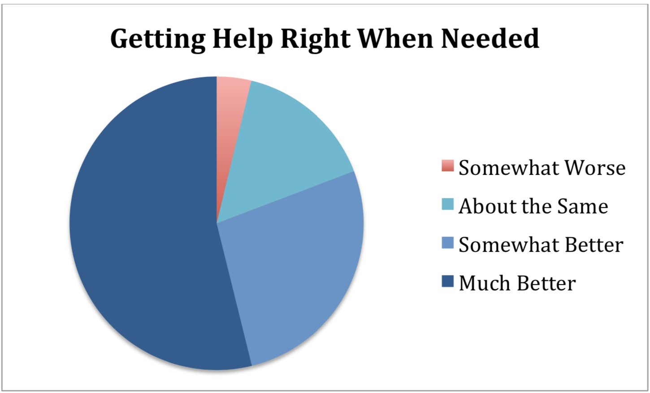
Cost and time are the largest barriers to mental health care

Slide 13


Fast response times increase continuity of service

Slide 14
Effectiveness of text therapy
Text therapy is shown to be just as effective as regular therapy

Slide 15
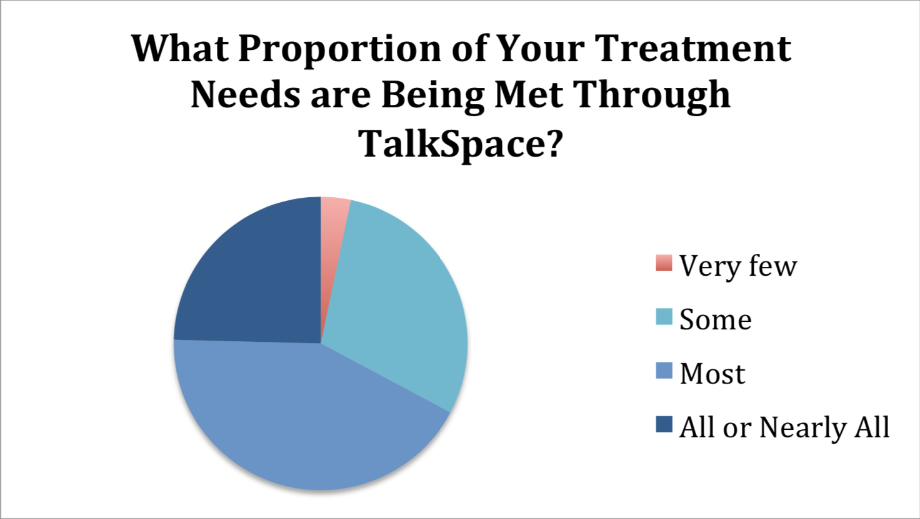
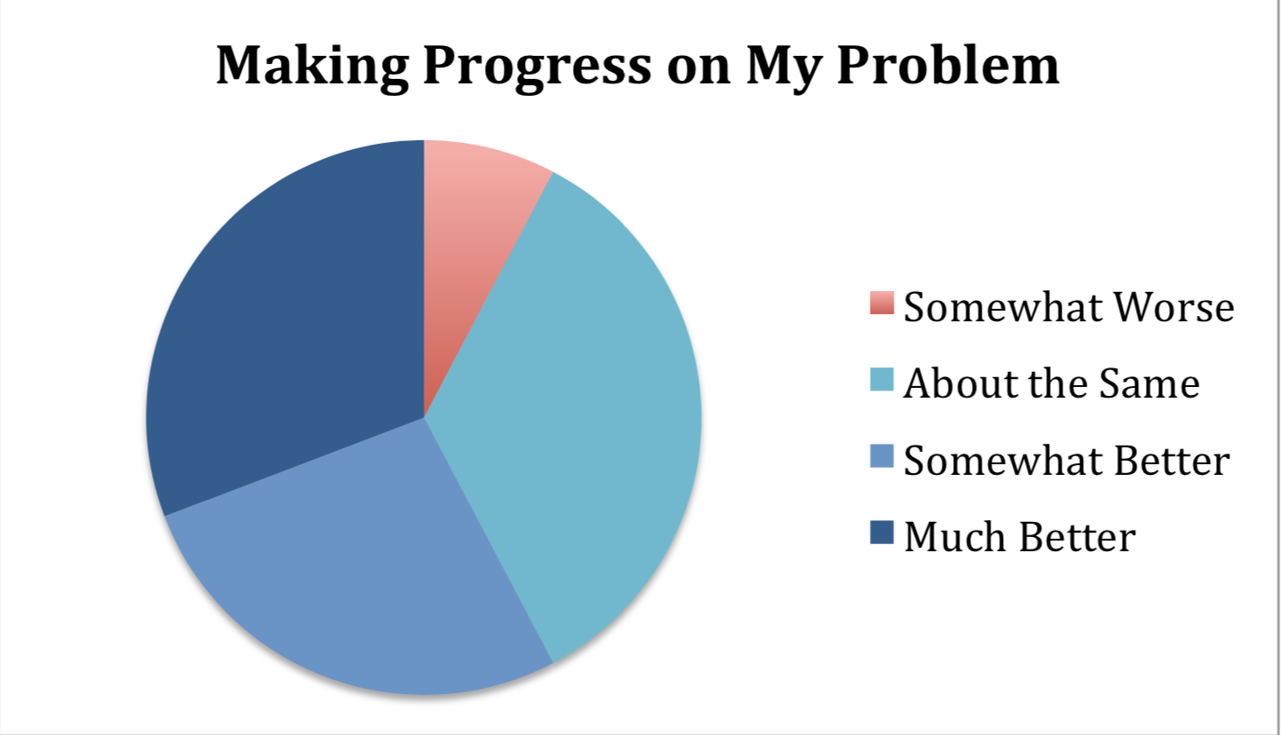
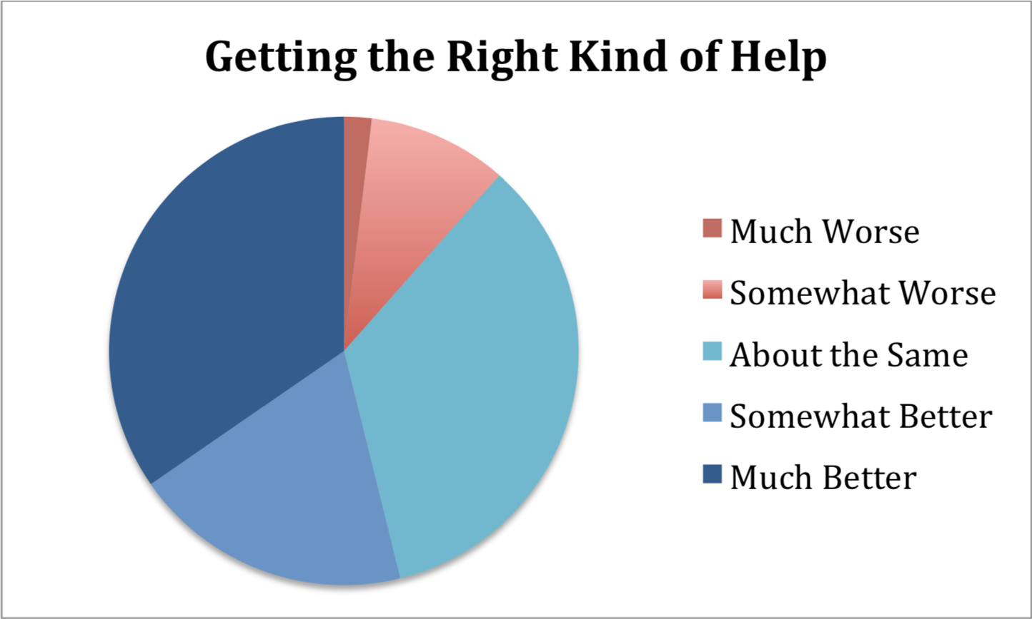
What people are saying
With this app, I’m confident to plan a trip to rural Vietnam
Wendy Writer, CA
Visual translation feels like magic
Ronny Reader, NYC
Translate has officially inspired me to learn French
Abby Author, NYC
Statistics from a Talkspace survey

